Slide 1

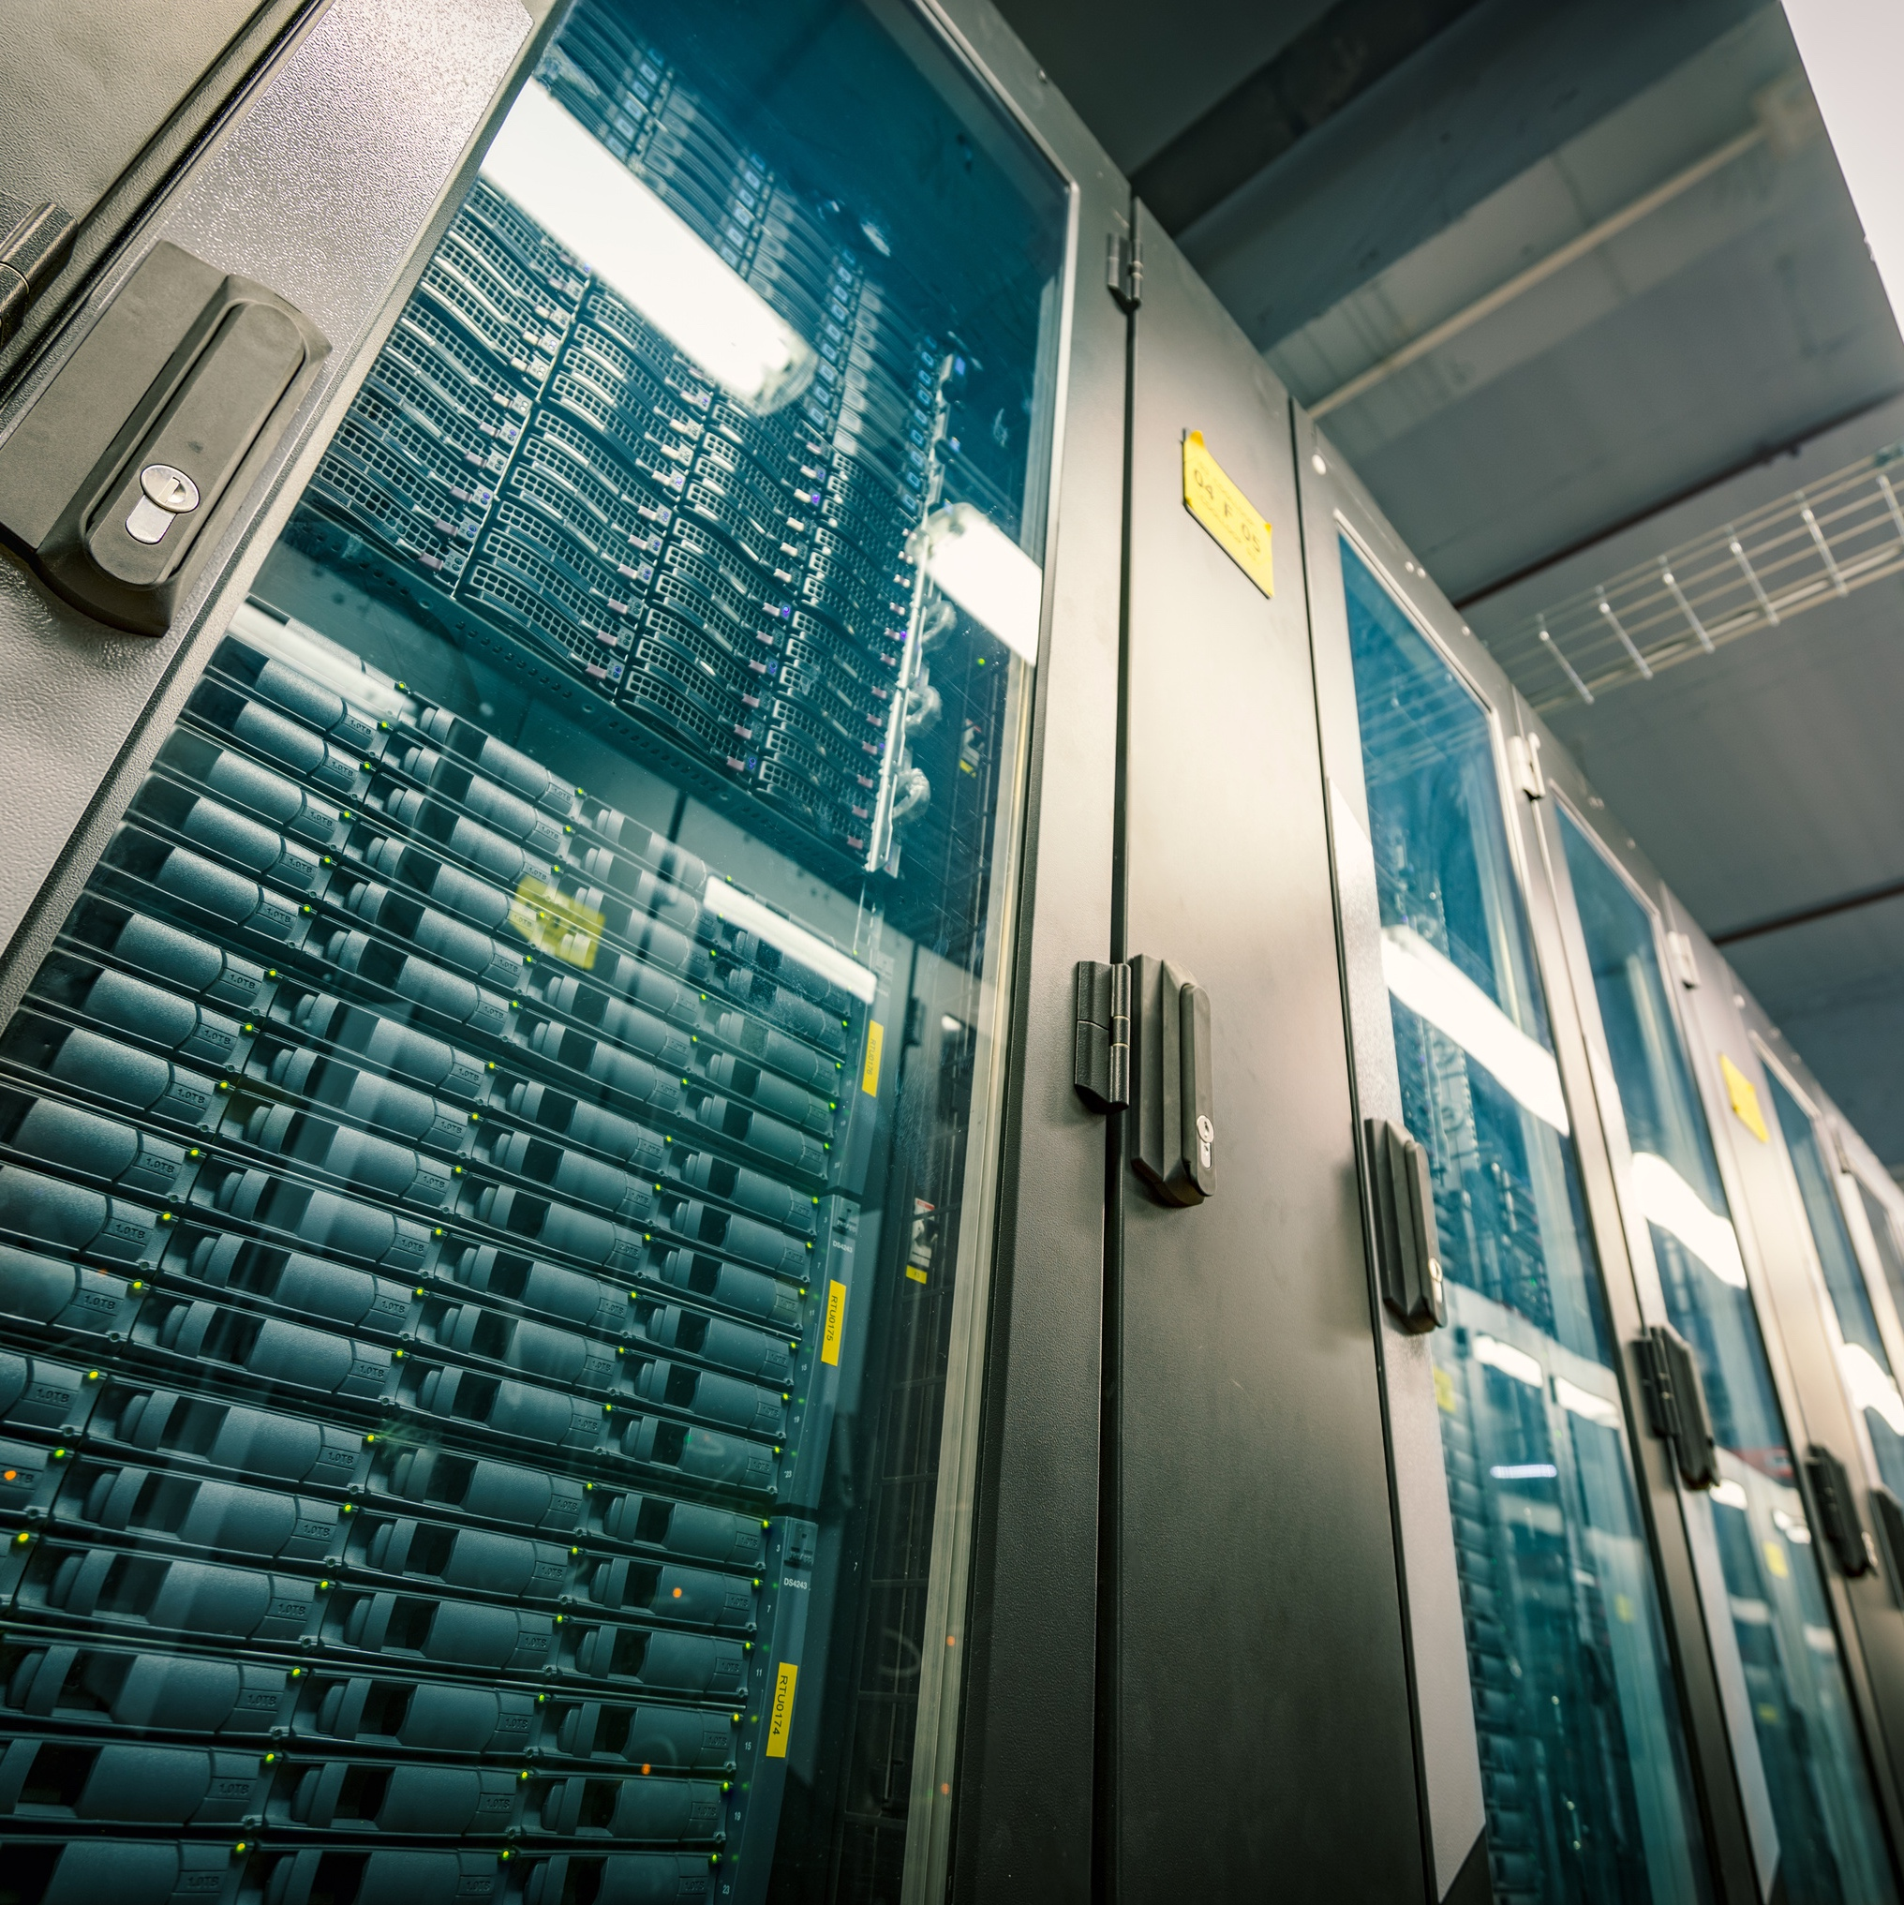

Data Centers
in Maryland
Strong Economy. Strong Communities.

Slide 2

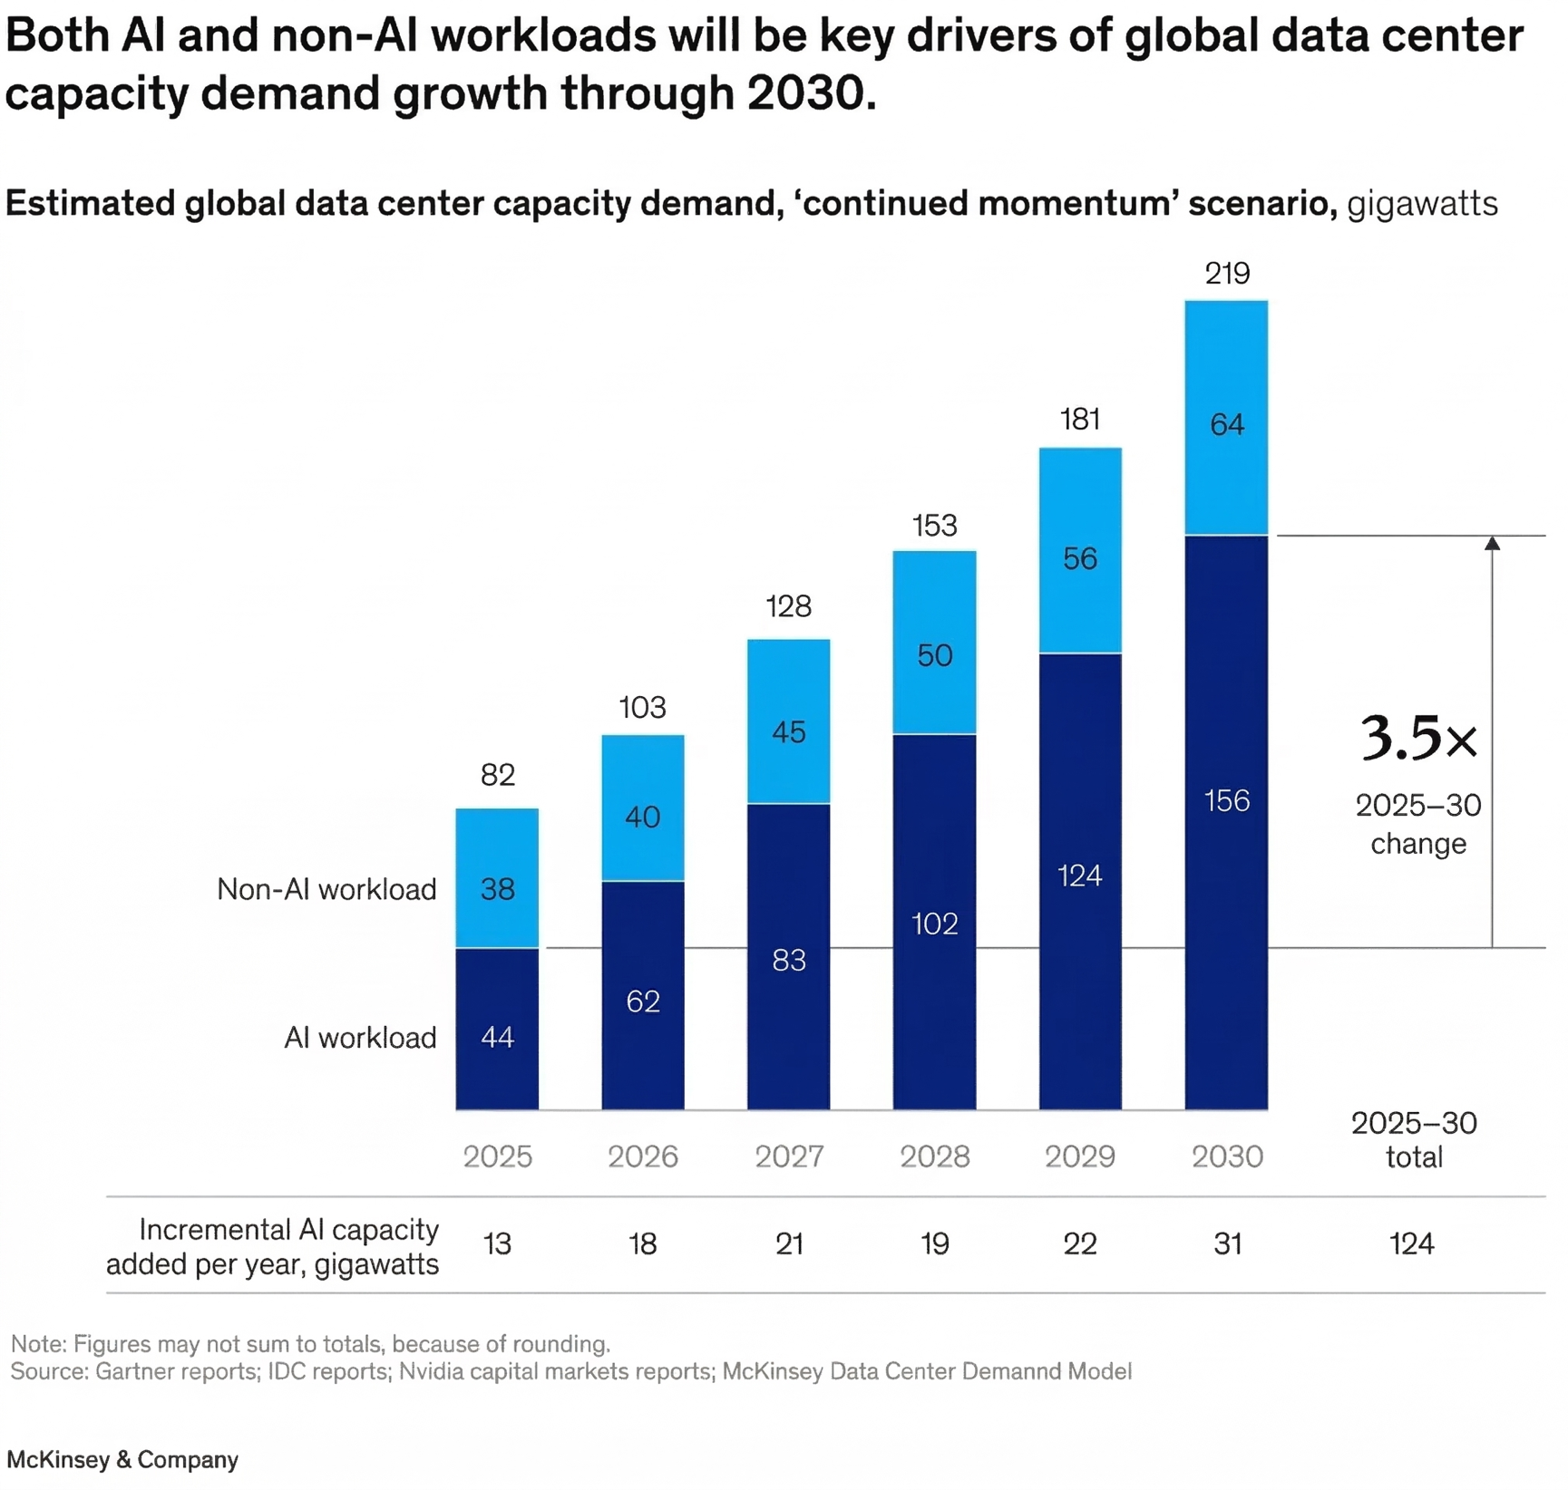
Why Data Centers are in Demand
Explosive growth in digital commerce, cybersecurity, and scientific R&D.
Non-AI data center workloads nearly double by 2030. Demand is not driven solely by AI.
This growth can only happen with data centers.
1 McKinsey & Co., ”Data Center Demand Charts,” May 2025

Slide 3

Why We Need Data Centers
If you engage in any of the following activities, you rely on a data center:
  1. Sent an email
  2. Watched video online
  3. Used GPS (e.g. Google Maps)
  4. Shared a photo online
  5. Purchased an item online
If you support any of the following initiatives, they only happen with data centers:
  1. Precision medicine and personlized treatments
  2. Continous glucose monitoring for diabetic care
  3. Cyber security to protect personal information
  4. Weather forecasting and severe storm warnings
  5. 911 emergency response

Slide 4
Economic Impact of Average Sized Data Center
5,000
Direct & Indirect Jobs During Construction
$775M
Economic
Activity
500
Permanent Jobs Supported Once Operational
The Economic & Fiscal Impacts of Data Center Development in Maryland, August 2025

Slide 5



Annual State Tax Revenues from a Single Data Center
171
Police Officer
Salaries
194
Firefighter
Salaries
165
Teacher
Salaries
Based on a 800,000 square foot, 300-megawatt data center, which generates $14 million in annual state tax revenue
* U.S. Bureau of Labor Statistics, Annual Mean Wages, May 2024
* The Economic & Fiscal Impacts of Data Centers in Maryland, Maryland Tech Council, August 2025

Slide 6
Current Economic Activities
in Maryland
300-400 electrical workers employed across Quantum Frederick and LTW sites in Hanover, MD.
100 new workers hired at prefabrication facility for Quantum Frederick
IBEW launched apprenticeship classes at Frederick Community College
240 apprentices accepted in
Year 1 — all are employed today.
IBEW projects 1,200 electrical workers for Quantum Frederick’s core and shell work.
Additional 800 workers estimated for tenant work
Source: International Brotherhood of Electrical Workers-Maryland

Slide 7
Frederick County: Local Tax Revenue
HR&A Advisors studied 16 million sq. ft. Quantum Frederick campus in Frederick County.
Estimated to generate $215 million in annual tax revenue revenue for the county once fully operational.³
Frederick County
Tax Revenue Increases by
$215 Million Annually
Massive increase in county funds for education, police, fire, and other serves
3 HR&A Advisors, Quantum Frederick Data Center Impact Analysis, October 2025

Slide 8
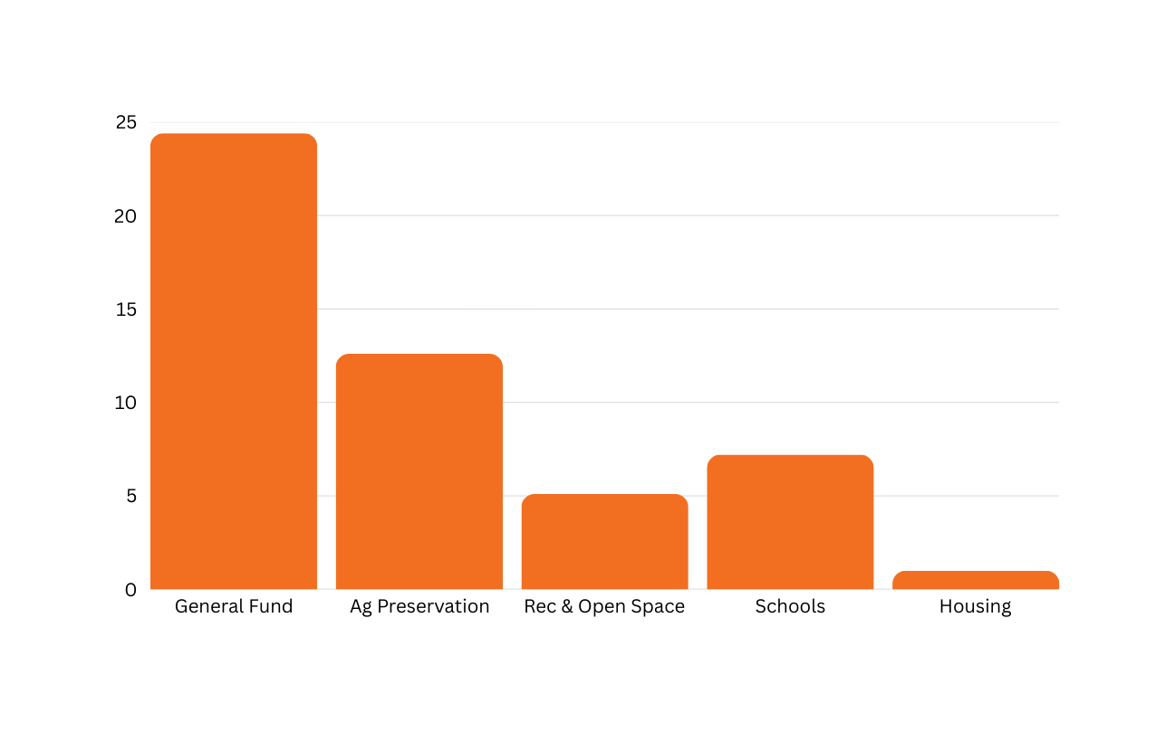
Frederick County: One-Time Recordation Taxes
Data center developers have paid $50.6M in recordation taxes to Frederick County.
$24.4 M
Allocation of $50.6 Million in Recordation Taxes
$12.6 M
Amount (Millions)
$7.2 M
$5.1 M
$1.0 M

Slide 9
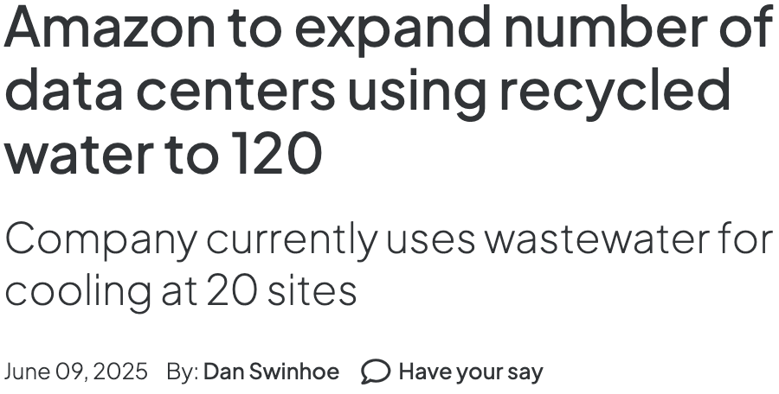
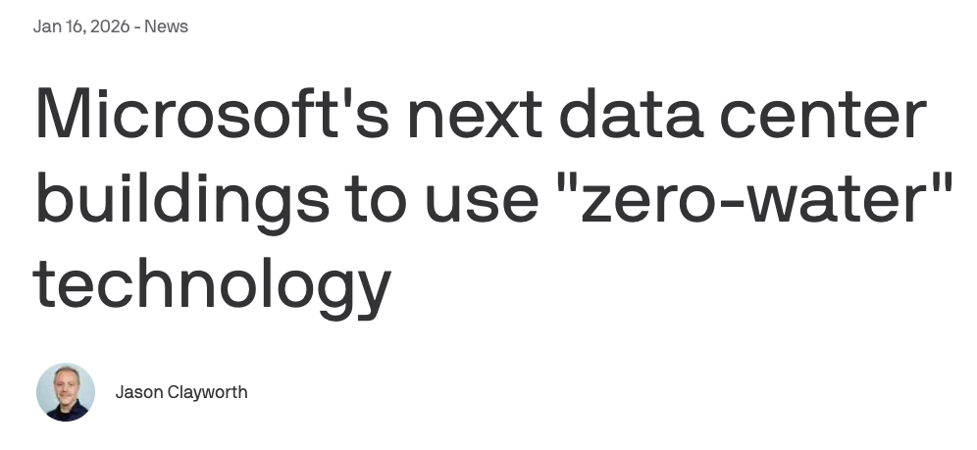
Conserving Water
Data centers use water, air, or liquid to cool servers.
Three new innovations reduce or eliminate water use for data center cooling:
Closed loop systems
Reclaimed wastewater
Air Cooling
U.S. golf courses use 97 percent more water than data centers.

Slide 10
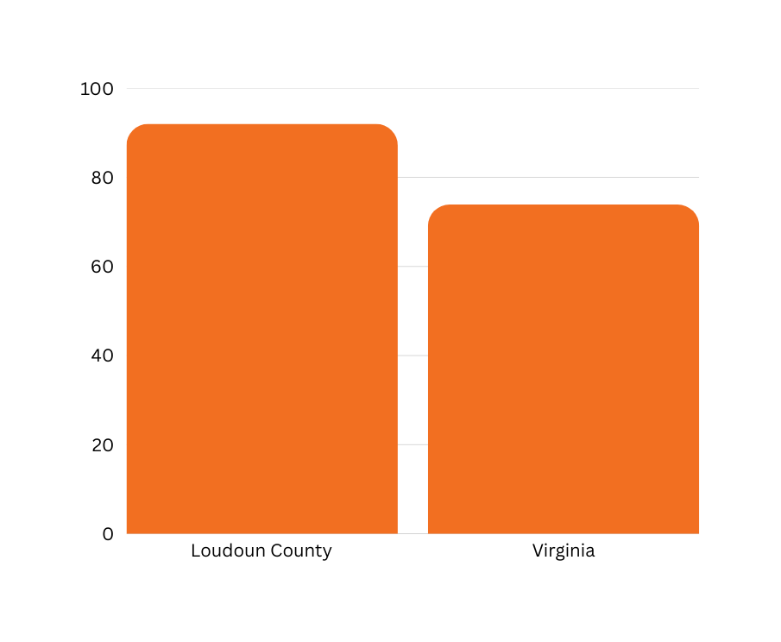
Home Prices
Loudoun County Outperformed Virginia 2010-2024
Home prices rose alongside data centers in Loudoun County, Va.
92%
73.9%
Median home price index up 92 percent from 2010 - 2024, faster than state average of 73.9 percent.⁴
Home Price Index Increase (%)
Loudoun County in top 2 percent of U.S. for median home prices ($775,457).
4 Federal Reserve Bank of St. Louis, All-Transaction House Price Index, Loudoun County and Virginia

Slide 11
Respecting Landscapes
Frederick County Plan:
  Limits data centers to less than 1% of county landmass.
  Developers put 5 acres of farmland into preservation for every 1 acre rezoned for data center development.
  Restricts data centers to 500+ ft. from residential neighborhoods
Thoughtful planning balances rural heritage and economic growth
Additional Best Practices:
  Noise buffers, tree plantings

Slide 12
Respecting Landscapes: Sound Levels
Local jurisdictions set noise ordinances.
ACTIVITY
Jet Taking Off
Loud Radio
Normal Conversation
Typical Data Center (from property line)
Rain
Whisper
SOUND LEVEL
140 decibels
80 decibels
60 decibels
55-60 decibels
40 decibels
20 decibels
Data centers must comply with these ordinances.
Many data centers operate below ordinance.
Sound reduction techniques:
  Tree plantings
  Noise shrouds
  Property line setbacks

Slide 13
Energy: Data Centers Pay for Grid Upgrades
New Maryland Law
“It is the intent of the General Assembly that residential retail electric customers in the state should not bear the financial risks associated with large load customers interconnecting to the electric system serving the state.”⁴
– Utility Relief Act of 2026
Data centers require energy—but must pay for it.
MD requires data center developers to pay for electric grid upgrades needed to serve their facility.
Today’s data centers are far more energy efficient than decentralized data servers.

Slide 14
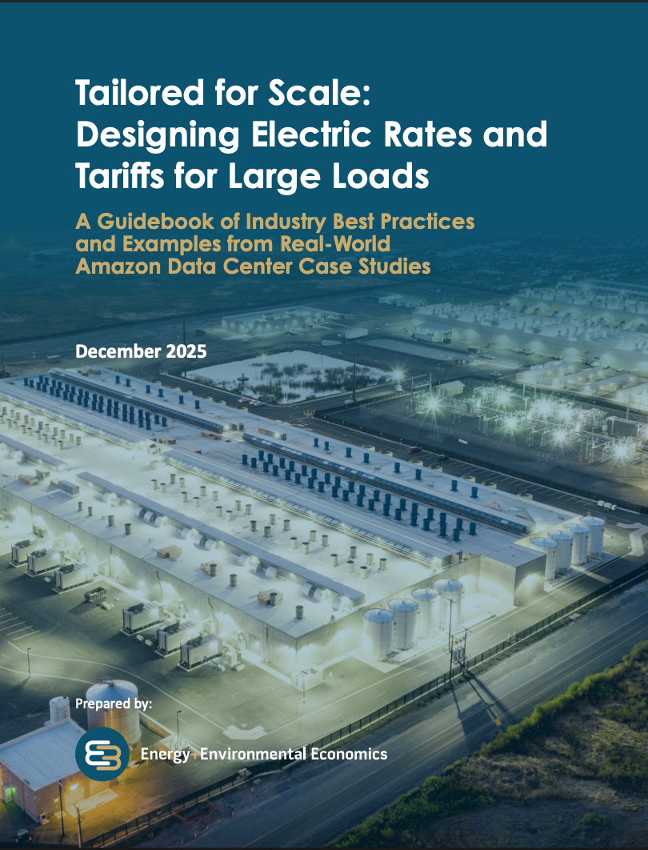
Study: Data Centers Can Help Lower Electricity Prices
Surplus electricity revenue data centers generate can be returned to ratepayers.
A single 100 MW data center can generate over $3 million in annual value to help reduce rates for other customers.
Why? More data centers = more large customers to pay for grid upgrades.
* ” Tailored for Scale: Designing Electric Rates and Tariffs for Large Loads

Slide 15

Prices are Declining in Many U.S. States
Pacific Gas & Electric cut electric rates by 11%, citing data center growth as a driver.
Indiana Michigan & Power is reducing base electric rates citing new revenue from data centers in its service area.
Dominion Power: Northern VA residential electric customers pay 10% below the national average on transmission costs because of data centers.

Slide 16
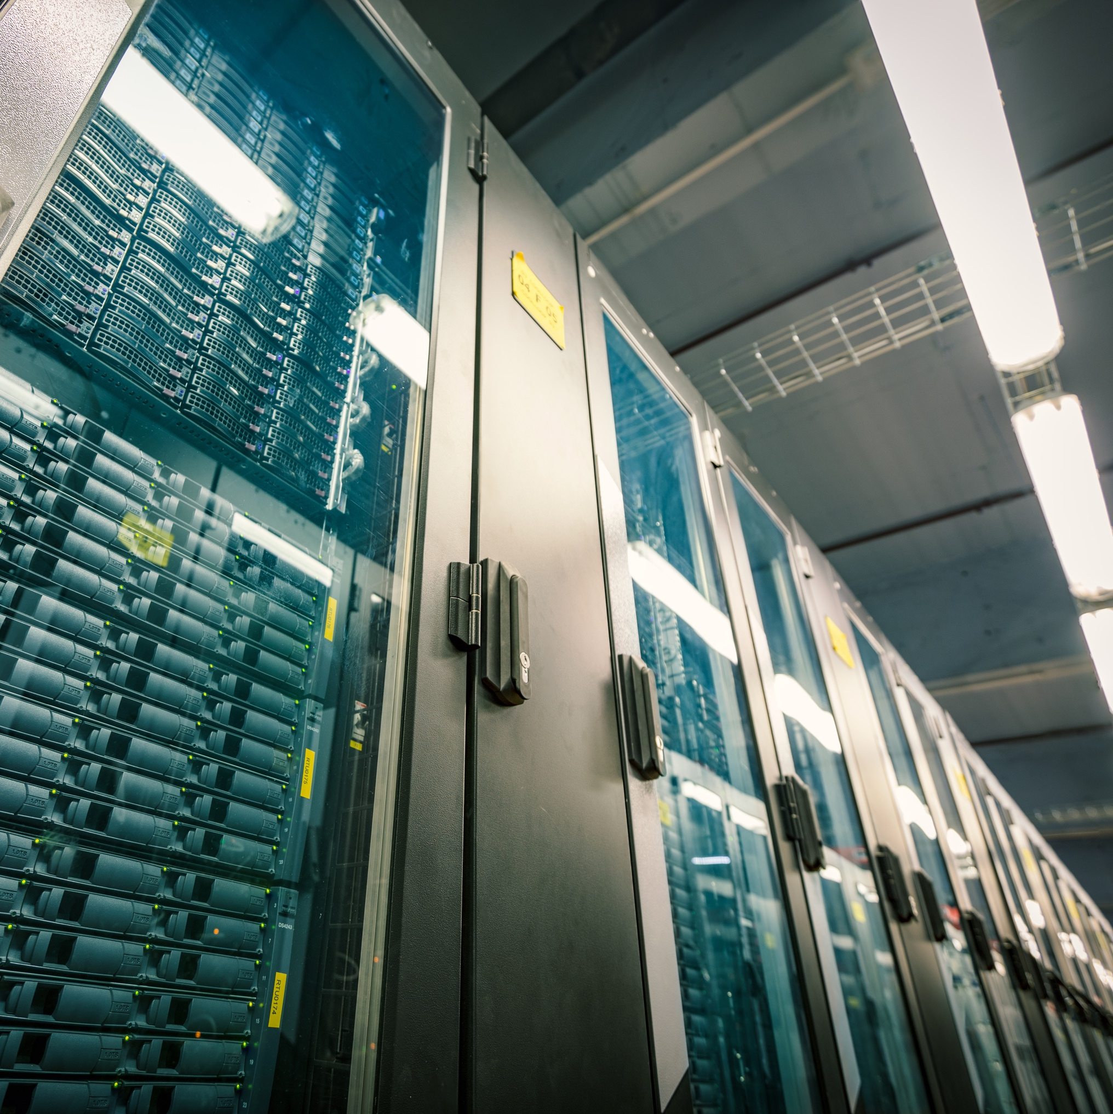

Learn More
bit.ly/dca-md

Slide 17




Proposed Data Center Development Information Session
Kelly Schulz
Maryland Tech Council
Meghan Sweigart
Tech Frederick
Kraig Walsleben
Rodgers Consulting
Joe Whitebread
Trammell Crow Company

