Slide 2
2020: A Year of Crazy Economic Data
Q2 GDP decline: 32.5%
April 20 spot price of crude oil (WTI): -$37 per bbl.
April U.S. job losses: 20.5 million jobs
U.S. gasoline consumption April: 27% decline
Decline in revenue passenger kilometers for international flights, April: 98.4 percent
Q3 GDP: 33.4%
Growth in government transfer payments, 2020: $1.3 trillion
Federal government deficit, FY 2020: $3.1 trillion (47% of total spending)
Montana personal income growth from 2020Q1 to 2021Q1: 20 %

Slide 3
2021 Economic Numbers Continue to Amaze
Every month the Federal Reserve is buying $120 billion worth of public and private debt ($3.1 trillion of Treasure notes purchased since March 2020)
The yield on the 10-year treasury bonds has hovered around 1.3 percent
The Consumer Price Index in June was 5.4 percent higher than year-ago levels
MLS data say that median sales price of Montana residential properties is up by 34.3 percent in June 2021
Job postings in Montana in July are 62 percent higher than February 2021

Slide 4
Is the Federal Reserve Paying Too Much Attention to the Coastal States? Standard Deviation of State Unemployment Rates, Monthly, 1976-2021
June 2021 Unemployment Rates:
California: 8.0%
New York: 7.3%
Montana: 4.0%
1980
1985
1990
1995
2000
2005
2010
2015
2020

Slide 5
Real GDP, U.S., Actual and Forecast Billions of Dollars
Jul-21 Forecast
Dec-19 Forecast
Jul-20 Forecast
Source: IHS Markit
2019
2020
2021
2022
2023

Slide 6
A Tough Year for Economic Predictions: What Made This Forecast So Wrong?
Pre-Covid Forecast
July 2021 Forecast
Montana Personal Income, Billions $
BBER April Forecast

Slide 7
Three Answers Come to Mind
The forecast is correct! The data are wrong!
It was not an economic downturn – it was a public health crisis with economic consequences
No one anticipated the speed and strength of the policy response

Slide 8
Transfers from Government Exploded in 2020 Transfer Payments, Montana, Millions of Dollars
$ Millions
$7.9 Billion!!!
Source: U.S. Bureau of Economic Analysis
2015
2016
2017
2018
2019
2020
2021

Slide 9
How Can We Reconcile These Two Trends?
2017
2018
2019
2020

Slide 10
Wages and Employment, Montana, 2018Q1 – 2020Q4 Seasonally Adjusted Index, 2017Q1 = 100
Percent
Wages
Employment
2018
2019
2020
Source: Quarterly Census of Employment and Wages

Slide 11
Job Losses by Sector, Montana, 2019Q4 – 2020Q4
Jobs
Source: Quarterly Census of Employment and Wages

Slide 12
Wage Loss/Growth by Sector, Montana, 2019Q4 – 2020Q4
Millions of Dollars
Source: Quarterly Census of Employment and Wages

Slide 13
Job Losses by Sector, Montana, 2019Q4 – 2020Q2 Seasonally Adjusted
Jobs
Source: Quarterly Census of Employment and Wages

Slide 14
Job Gains by Sector, Montana, 2020Q2 – 2020Q4 Seasonally Adjusted
Jobs
Source: Quarterly Census of Employment and Wages

Slide 15
Montana’s Recession Experience
Employment, Wages and Salary and Income Growth, Actual and Forecast, Percent
Source: IHS Markit

Slide 16
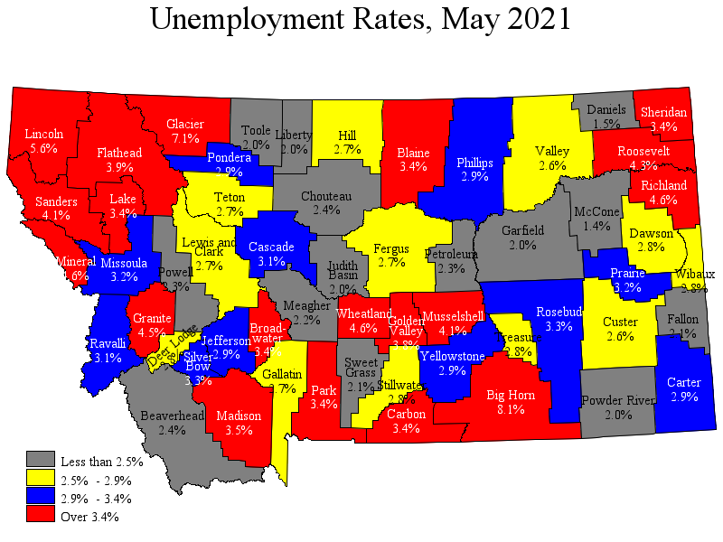
Source: Montana Dept. of Labor and Industry

Slide 17
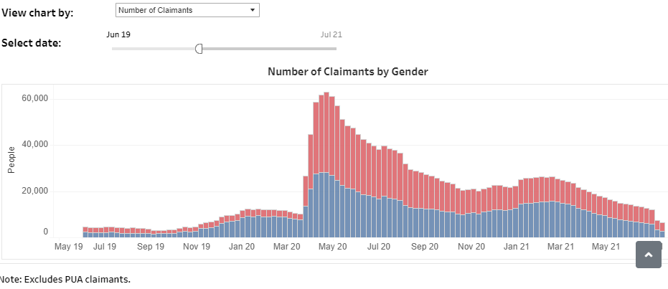

Slide 18
Commodity Prices Running Stronger
Metals & Energy
(as of June 2021)
Materials & Foodstuffs
(as of June 2021)
Low
High
Low
High
485 [Current]
7581.02
($ per
Thous. BF)
335
1479
($ per
Pound)
3105.10
9880.94
4.08
1994.22
2721.2
($ per
Bushel)
2.04
4.26
($ per
Ounce)
856.0
2873.1
2.47
1.34
($ per
Pound)
1.68
2.58
($ per
Pound)
0.86
1.60
6.50
71.38
($ per
Bushel)
3.63
7.58
($ per
Barrel)
16.81
71.38

Slide 19
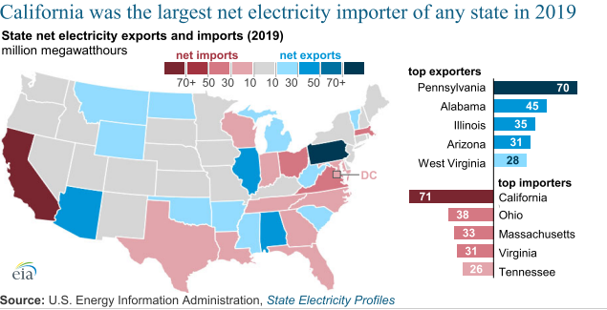

Slide 20
Bakken Oil Production Has Fallen Significantly Montana and North Dakota Monthly Crude Oil Production, Thousand Barrels
North Dakota (left axis)
Montana(right axis)
Source: U.S. Energy Information Administration

Slide 21
What’s Ahead for Montana’s Economy
Gains from re-opening have been very strong
Workforce shortages and housing costs are symptoms of the same issue – a supply-constrained economy with too much stimulus
Drought looms large for ag producers
2021 will be a big year, but what’s ahead?

Slide 22
BBER has addressed the two of the biggest issues in the Montana economy in recent years

Slide 23
Voluntary Quits Signal Labor Market Health
Quits as a Share of Total Employment, Western Region Percent
2018
2019
2020
2021

Slide 24
Wage Growth Tilted Towards Startup Positions Federal Reserve Bank of Atlanta U.S. Wage Tracker, Percent
Lowest 25% earning jobs
Highest 25% earning jobs

Slide 25
Percent
Montana has had more job openings since February 2020 than any other state
%change in job openings, Feb 2020 – July 2021
Source: Indeed.com

Slide 26
What Companies Can Do
Pay people more. This is already happening. Does it grow the total workforce?
Search more broadly. Relax requirements. Look at non-traditional workers. Look outside local area, especially if remote work is feasible.
Invest more in training. Hiring less qualified workers requires more training to bring them up to acceptable skill levels, even if there is a risk they will leave and take work elsewhere.
Reconfigure job roles. Find ways to make existing staff more productive to cover needed functions with existing workers.
Recruit future workers. Connect with middle school-aged people to raise awareness of career opportunities.
Automation and outsourcing.
Turning down work.

Slide 27
What Policymakers Can Do (But maybe not if they want to get re-elected)
Boost retirement age. Social Security and Medicare need this change eventually anyway.
Increase female labor force participation. More flexibility and a big expansion in child care availability is needed.
Fix immigration policy. Has always been a U.S. strength.
Raise teenage participation. Compatible with college prep?
Re-think drug testing policies. This is quietly happening already.
Reconsider occupation licensing requirements. These make it harder for two-earner couples to migrate to job opportunities.
Explore employment of incarcerated population.

Slide 28
All Transactions Housing Price Index, Montana Percent Growth, Annualized Rate, Not Seasonally Adjusted
2018
2019
2020
2021
Source: Federal Home Finance Agency

Slide 29
Housing Price Growth, Percent, 2019-2020

Slide 30
Residential Construction Has Responded Montana Housing Starts, Units, Single and Multi-Family

Slide 31
What’s the Solution?
It Depends on What You Think is the Problem

Slide 32
The Market is the Problem
“Hot” housing markets have high in-migration and high demand
Land use policies and regulation reflect the “proper” pricing of the spillover effects of new housing
Solution is to subsidize those who have difficulty paying
Housing programs vs. poverty programs

Slide 33
The Problem is Regulation and Policy
Local regulation constricts housing supply, pushing prices up beyond construction costs plus profit
Federal policies inflate demand for larger, more expensive homes
No single rule or regulation is the culprit
Solution is rollback or override of local regulatory power – from the state?

